Slide 1
Contributing to the Alma Community Zone
Yoel Kortick
Senior Librarian

Slide 2

Agenda
Introduction
Editing CZ Bibliographic records
Contributing Portfolios to the CZ
Contributing Local Electronic Collections to the CZ
The Community Zone Management Group

Slide 3
Introduction
3

Slide 4
Introduction - Goals
The goals of Community Zone contribution are:
To have high quality descriptive records in the Community Zone Catalog
To have both individual portfolios as well as entire collections which
    Meet the needs of the community
    Are added to the Community Zone at a speedy pace
Therefore, Alma includes options to allow the library staff to play an active role and collaborate in the Community Zone.

Slide 5
Introduction – What can be contributed?
The Community Zone offers users the opportunity to
Update bibliographic records
Add portfolios to specific existing collections
Contribute entire collections.

Slide 6
Introduction – Update bibliographic records
By allowing institutions to enrich records directly in the Community Zone, everyone can benefit from the work of other libraries in the community.
Any change to Community Zone bibliographic records is automatically reflected in the records at every institution that uses the Community Zone bibliographic record.

Slide 7
Introduction – Portfolio contribution
Portfolios can be contributed to the following electronic collections:
Portfolio contributions can be made to the following electronic collections:
Free E- Journals – collection ID 61110976638852340
Miscellaneous Ejournals – collection ID 61111016833201000
Miscellaneous Free eBooks – collection ID 611000000000001091
Miscellaneous eBooks – collection ID 611000000000001090
U.S. Government Documents – collection ID 613170000000000069
Freely Accessible Business Journals – collection ID 615280000000001780
Freely Accessible General Interest Journals – collection ID 615280000000001781
Freely Accessible Arts & Humanities Journals – collection ID 615280000000001779
Freely Accessible Social Science Journals – collection ID 615280000000001783
Freely Accessible Science Journals – collection ID 615280000000001782
Freely Accessible Medical Journals – collection ID 614910000000003147
NewspaperARCHIVE.com – Collection ID: 613780000000001293

Slide 8
Introduction – Portfolio contribution
See also:
Community Zone Contribution Guidelines
Contributing to the Community Zone –Bibliographic Records

Slide 9
Editing CZ Bibliographic records
9

Slide 10
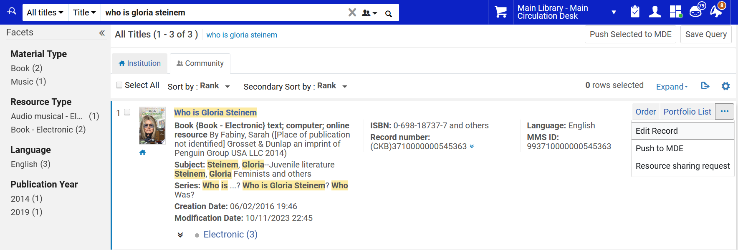
Editing CZ Bibliographic records
Search CZ via ‘All Titles’, click ‘Edit Record’

Slide 11
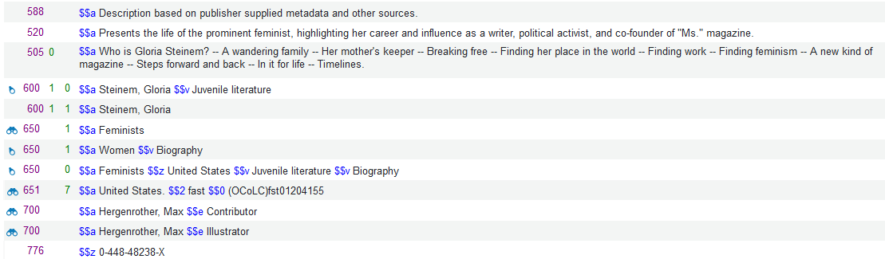
Editing CZ Bibliographic records
The record opens in the Metadata editor.
Here we see that it has four 65X subject fields.

Slide 12
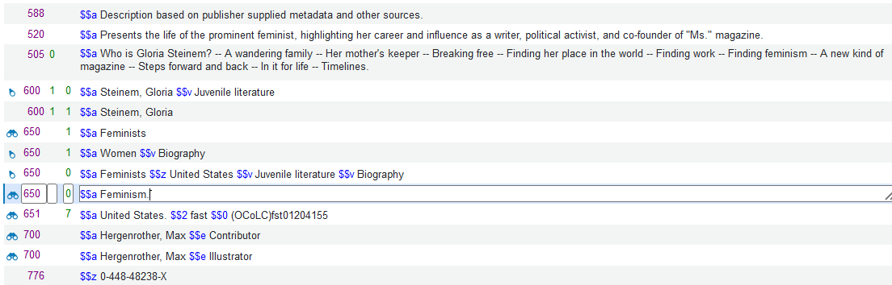
Editing CZ Bibliographic records
We add an additional subject 65X subject field.

Slide 13
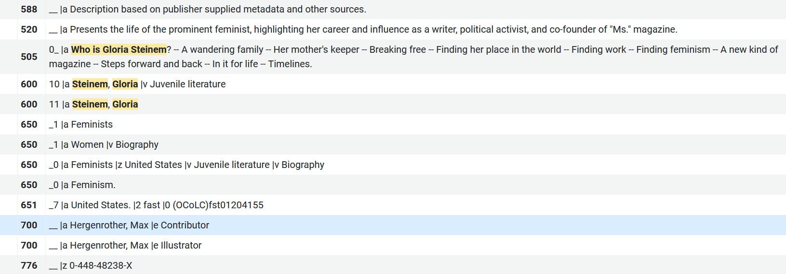
Editing CZ Bibliographic records
After saving the change is automatically reflected in the CZ record and every institution in the world immediately sees the new version.

Slide 14
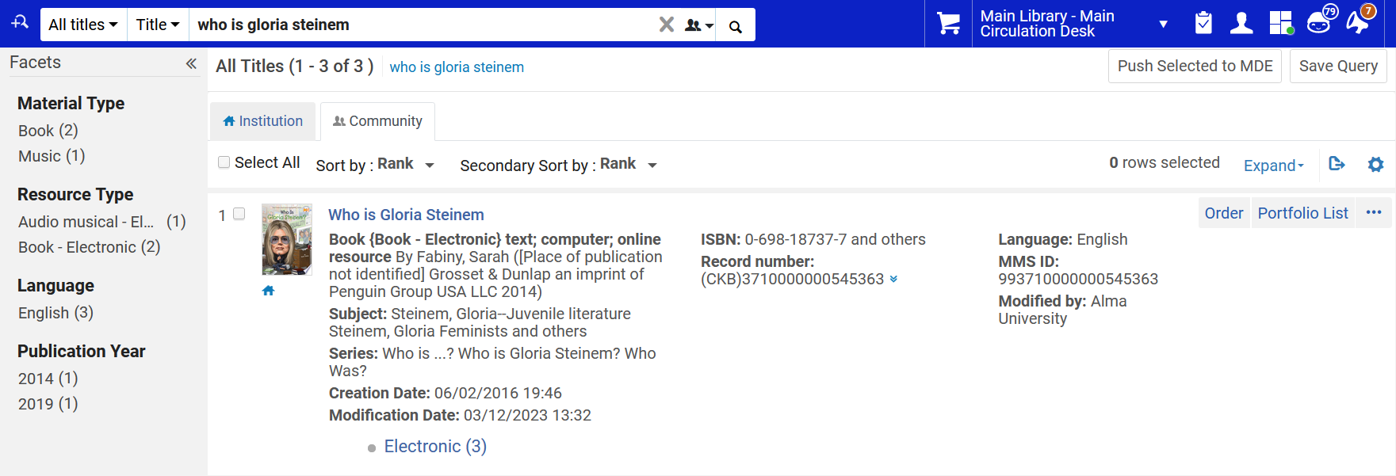
Editing CZ Bibliographic records
All institutions can also see who did the editing.
This is evident in the “Modified by” field.

Slide 15
Contributing Portfolios to the CZ
15

Slide 16
Contributing Portfolios to the CZ
As stated earlier, portfolios can be contributed to the following electronic collections:
Free E- Journals – collection ID 61110976638852340
Miscellaneous Ejournals – collection ID 61111016833201000
Miscellaneous Free eBooks – collection ID 611000000000001091
Miscellaneous eBooks – collection ID 611000000000001090
U.S. Government Documents – collection ID 613170000000000069
Freely Accessible Business Journals – collection ID 615280000000001780
Freely Accessible General Interest Journals – collection ID 615280000000001781
Freely Accessible Arts & Humanities Journals – collection ID 615280000000001779
Freely Accessible Social Science Journals – collection ID 615280000000001783
Freely Accessible Science Journals – collection ID 615280000000001782
Freely Accessible Medical Journals – collection ID 614910000000003147
NewspaperARCHIVE.com – Collection ID: 613780000000001293

Slide 17
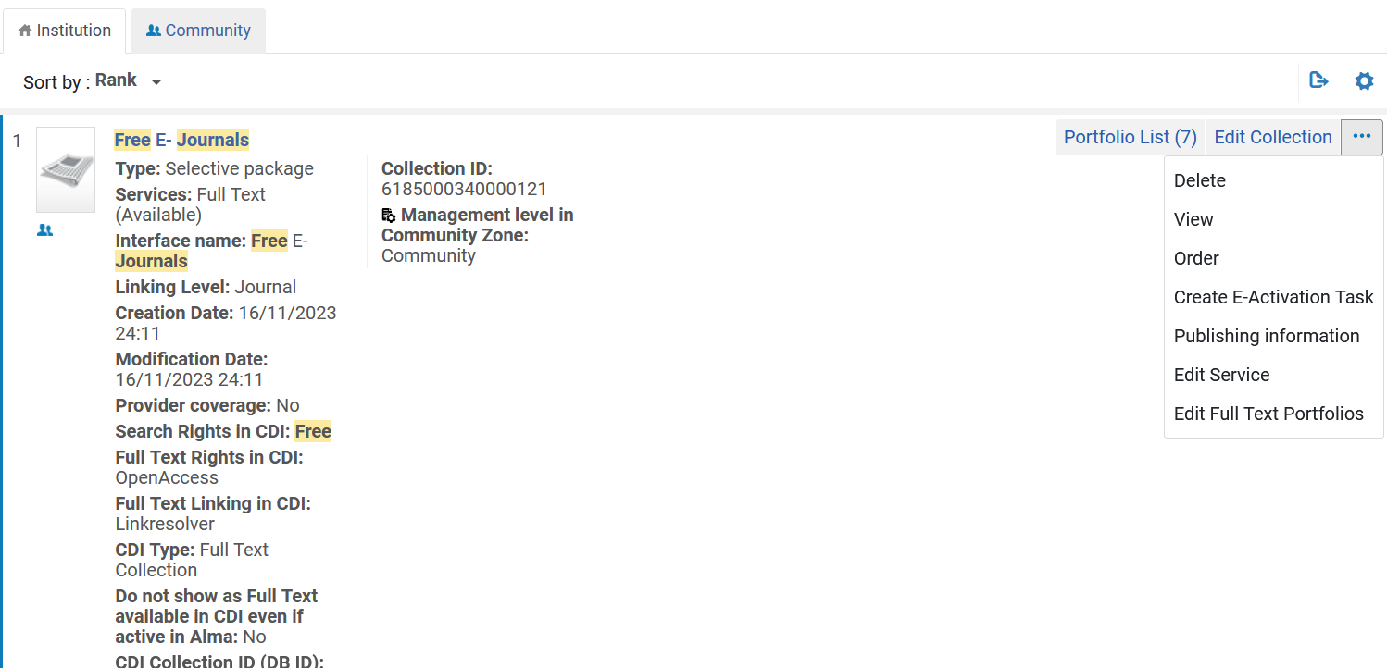
Contributing Portfolios to the CZ
Search institution for one of the collections and from the results choose “edit service”

Slide 18
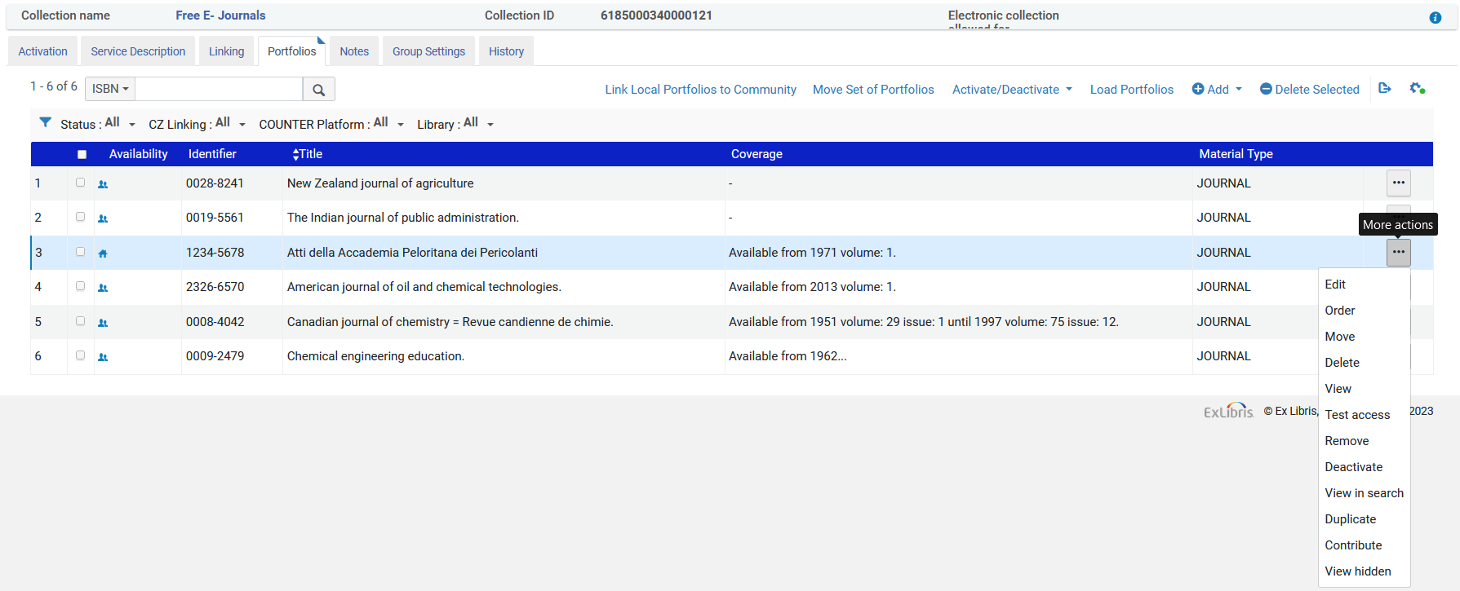
Contributing Portfolios to the CZ
Switch to the “Portfolios” tab and on the portfolio which will be contributed select ‘actions > contribute’
We can see that now this is not linked to the CZ

Slide 19
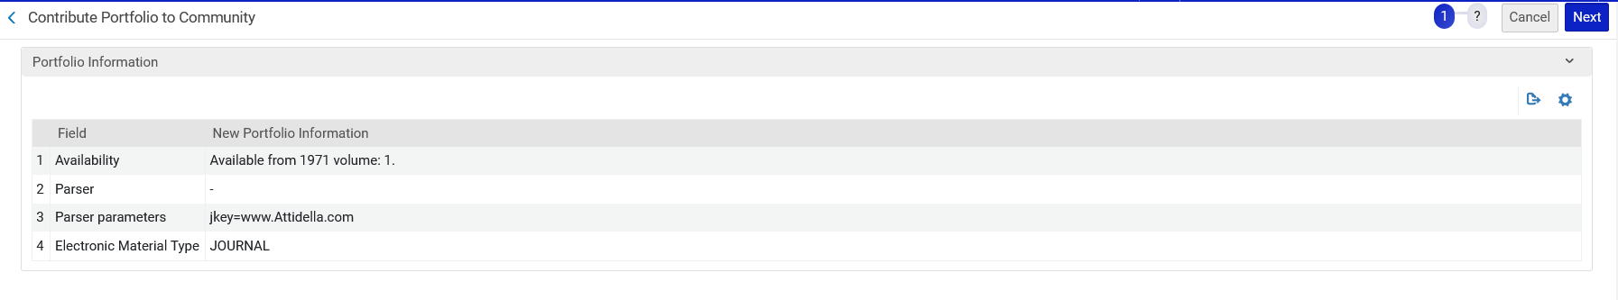
Contributing Portfolios to the CZ
Confirm by clicking “Next”

Slide 20
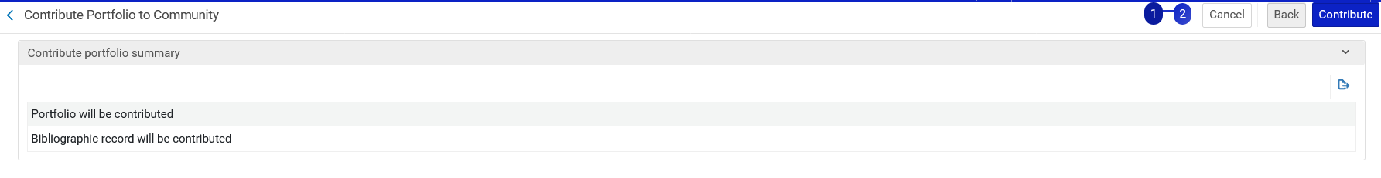
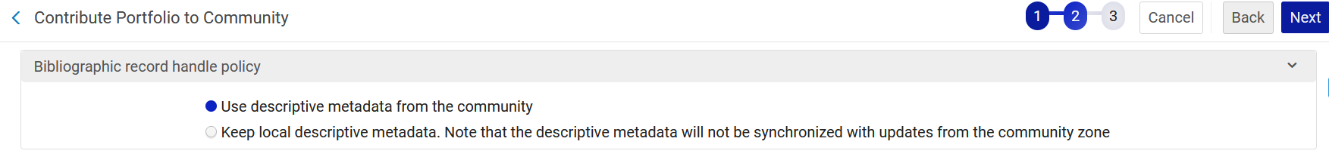
Contributing Portfolios to the CZ
Click “Contribute” (first screenshot).
Note that if there was a matching record in the Community Zone then Selecting “Use descriptive metadata from the community” will associate the portfolio with the matched Community Zone bibliographic record (second screenshot).
Our record does not have a match in the CZ so we have this option
When there is a match in the CZ this option appears.

Slide 21
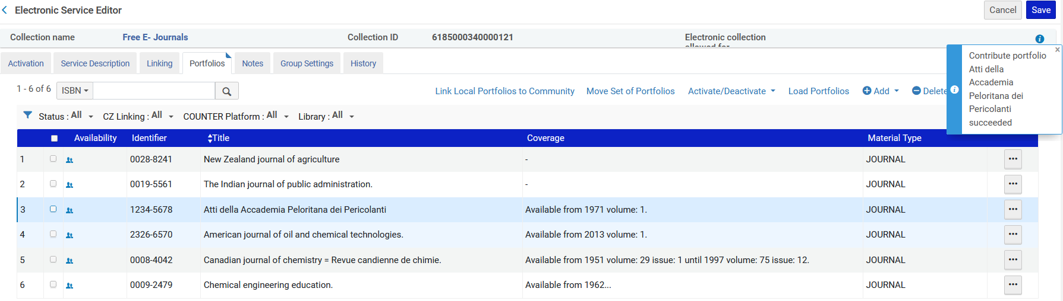
Contributing Portfolios to the CZ
The portfolio has been contributed
We can see that now this is linked to the CZ

Slide 22
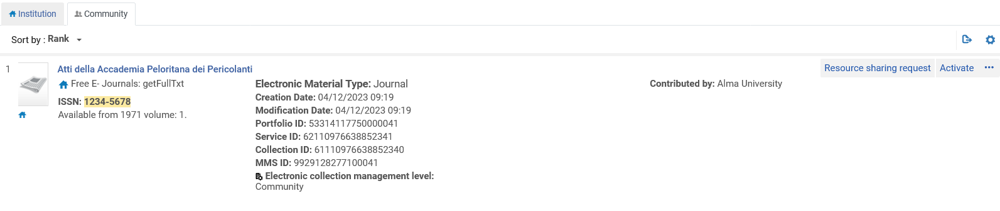
Contributing Portfolios to the CZ
The portfolio has been contributed to the Community Zone.
This will occur approximately 24 hours after the institution does the contribution.
The Ex Libris content team needs to approve the approval before it appears in the Community Zone.

Slide 23
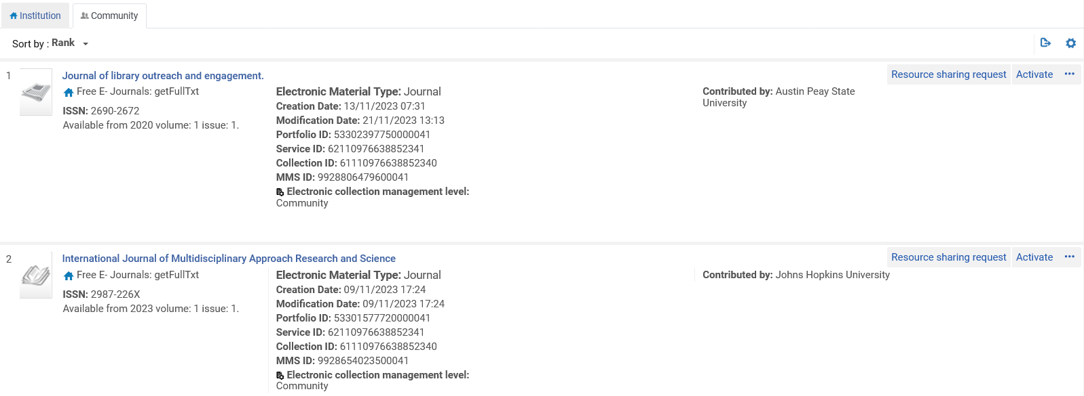
Contributing Portfolios to the CZ
When electronic portfolios are contributed to the Community Zone there is a clear indication of which institution contributed it.

Slide 24
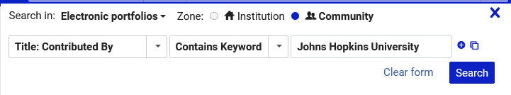
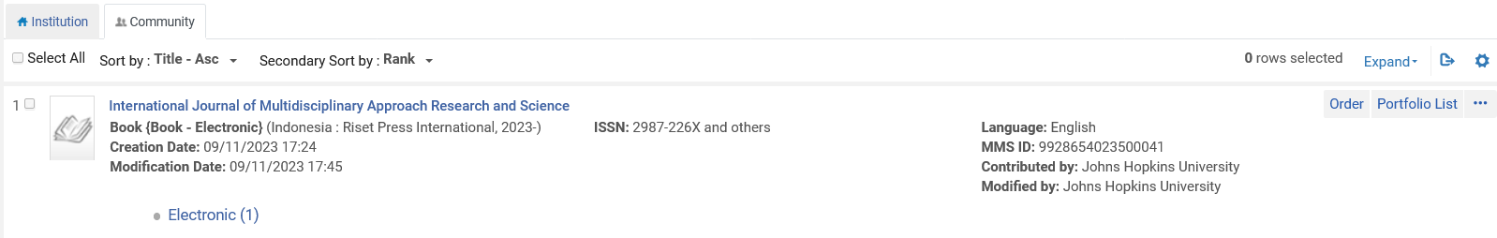
Contributing Portfolios to the CZ
It is also possible to search according to which institution contributed portfolios

Slide 25
Contributing Local Electronic Collections to the CZ
25

Slide 26
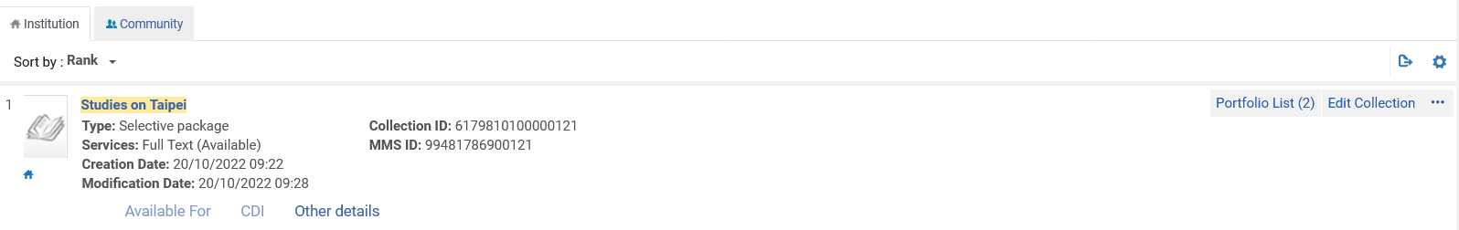
Contributing Local Electronic Collections to the CZ
To contribute a local electronic collection to the Community Zone:
Edit the local electronic collection that you want to contribute to the Community Zone.
In the Electronic Collection Editor click “Contribute to Community”.
The electronic collection is local

Slide 27
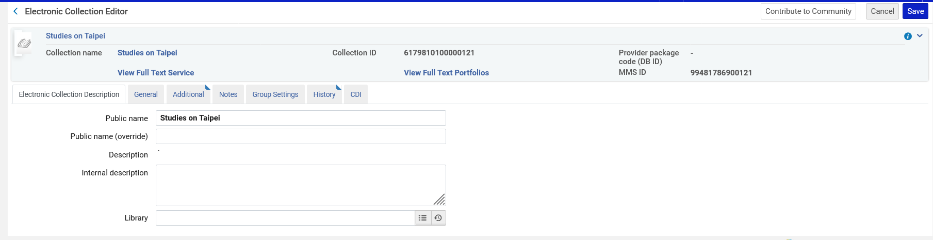
Contributing Local Electronic Collections to the CZ
Click “Contribute to Community”.

Slide 28
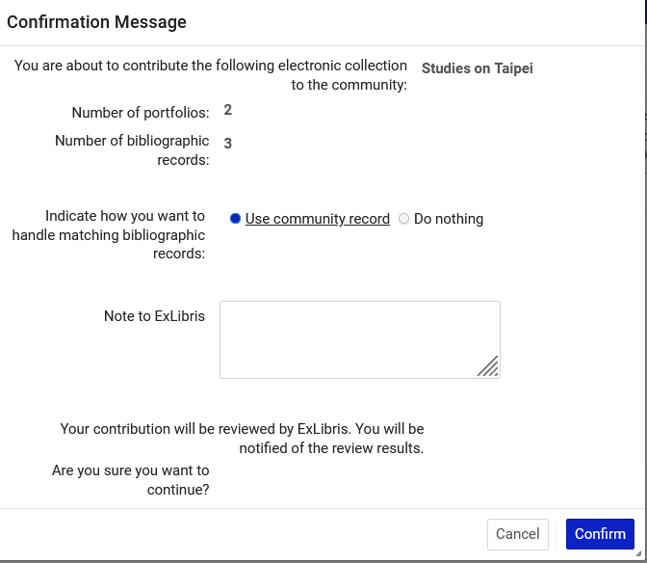
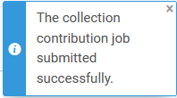
Contributing Local Electronic Collections to the CZ
Confirm the contribution

Slide 29
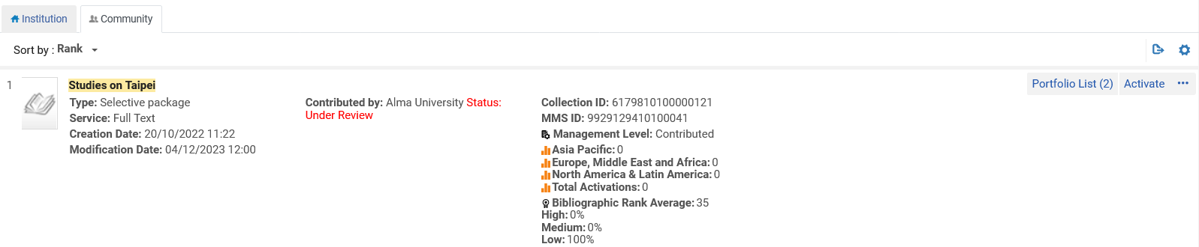
Contributing Local Electronic Collections to the CZ
Until the contribution is approved by the Ex Libris content team it will appear in the Community Zone as “Under review”.

Slide 30
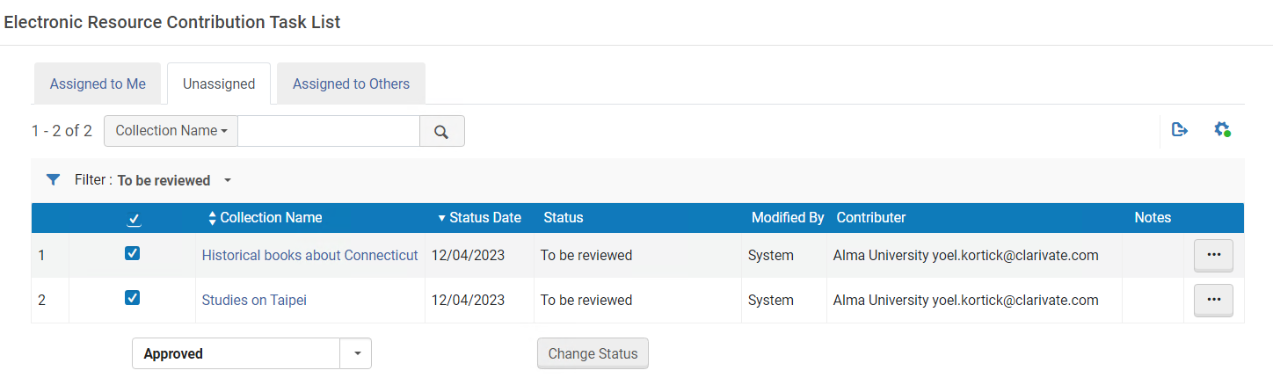
Contributing Local Electronic Collections to the CZ
“Behind the scenes” the Ex Libris content team will change the status from “To be reviewed” to “Approved”.

Slide 31
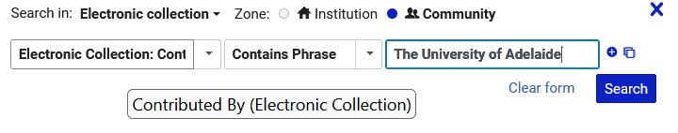
Contributing Local Electronic Collections to the CZ
It is possible to search Electronic Collections in the Community Zone by the institution which contributed the Electronic Collection

Slide 32
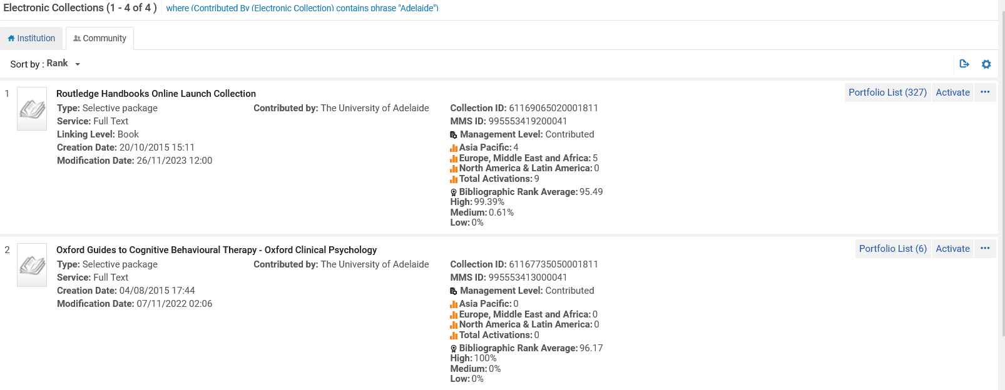
Contributing Local Electronic Collections to the CZ
Here we see in the Community Zone Electronic Collections contributed by The University of Adelaide.

Slide 33
The Community Zone Management Group
33

Slide 34
The Community Zone Management Group
The Community Zone Management Group (CZMG) is a sub-group of the Alma Product Working Group (PWG)
Among other responsibilities it works to enforce the Community Zone Advisory Guidelines.
The CZMG works together with Ex Libris in maintaining and updating these guidelines as needed.
The group is a “work in process”

Slide 35
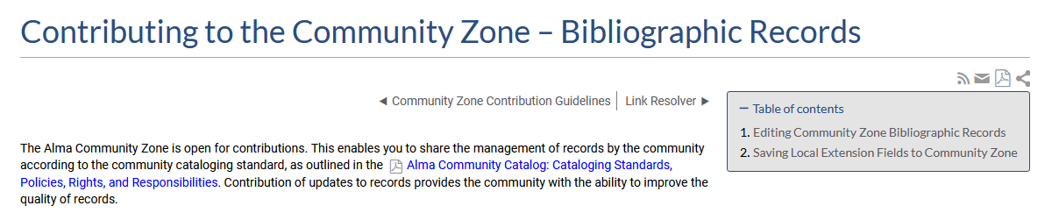
The Community Zone Management Group
The Community Zone Advisory Guidelines are available via a PDF document which is referenced in the Alma On Line Help at Contributing to the Community Zone – Bibliographic Records .
PDF document

Slide 36
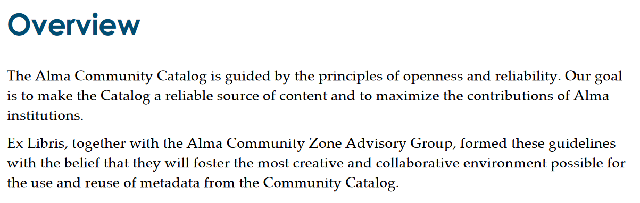
The Community Zone Management Group

Slide 37
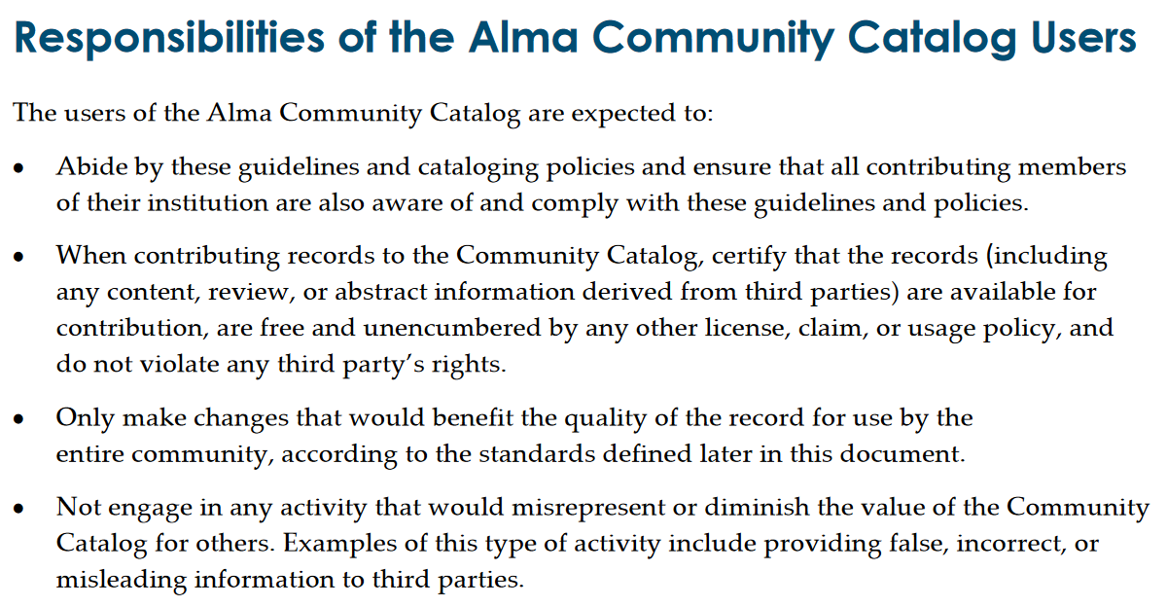
The Community Zone Management Group

